Slide 1

‘Studies On The Synthesis Of Ammine-Carbonato Series Of Zinc and Manganese’
A Project
for
Master’s degree in Analytical Chemistry
Submitted by
Mr. Sujit Subhash Pawar
Roll No. 228482

Slide 2
CONTENTS
Introduction
Objectives
Materials and Methodology
Characterization
Result and Discussion
Applications
Conclusion
References

Slide 3
INTRODUCTION
It has been proven experimentally that in the presence of alkali bicarbonates complex salt of chloride gives colour by the action of hydrogen peroxide on the aqueous solution, and such reactions can be used for colourimetric determination of Zinc and Manganese.
This method has been used before for studying the synthesized metal complexes of an ammine-carbonato series of Cobalt (III) complexes by Motoshichi Mori. A similar method would be used here to study the synthesis of ammine-carbonato series of Zinc (III) and Manganese (III) complexes.
The present study was started by isolation of the complex salt and then identifying its chemical formula followed by synthesis of Zinc (III) and Manganese (III) complexes belonging to an ammine-carbonato series.

Slide 4
OBJECTIVES
To synthesis Zinc(III) and Manganese(III) complexes belonging to an ammine-carbonato series.
Identifying its chemical formula by characterization of products.
To get pure and high quality product.
To explore the potential applications of these metal complexes in various fields.

Slide 5



Materials and Methodology
Mixed Drop By Drop
Filtration

Slide 6
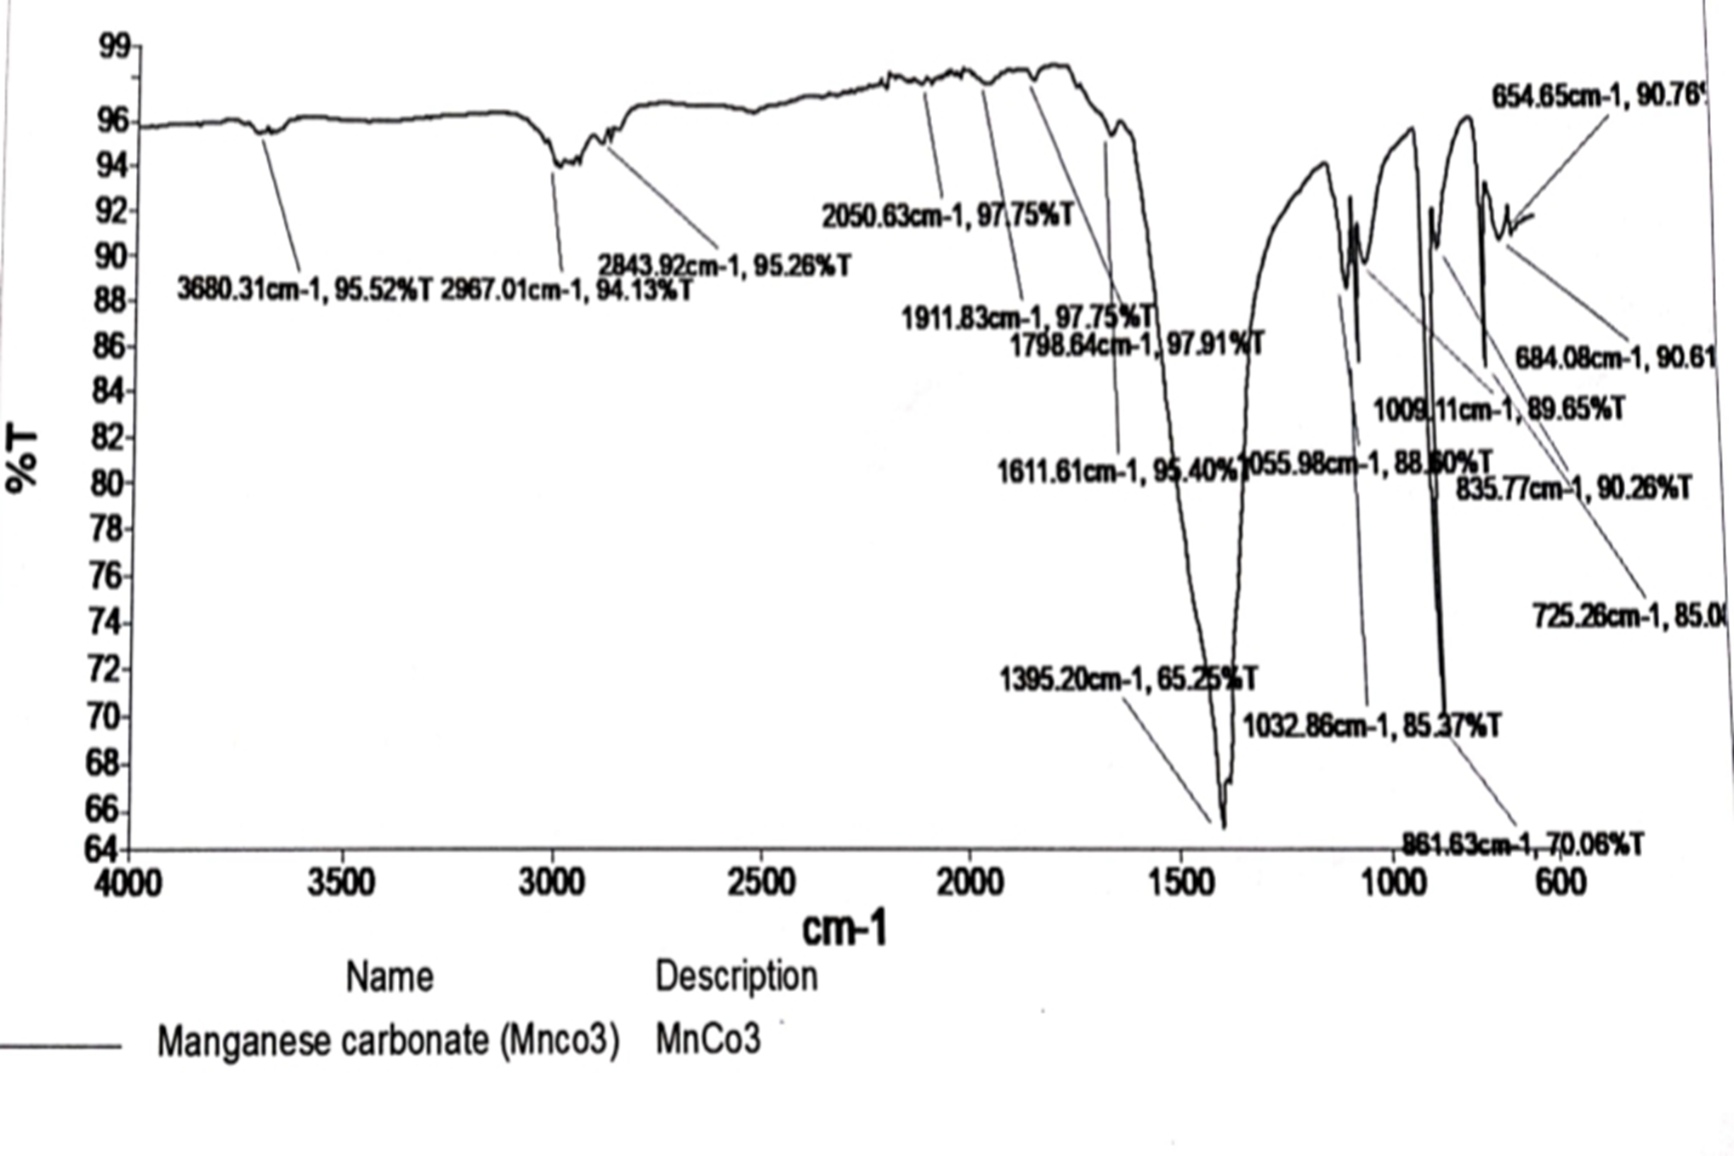
CHARACTERIZATION
Sodium tricarbonato manganese

Slide 7
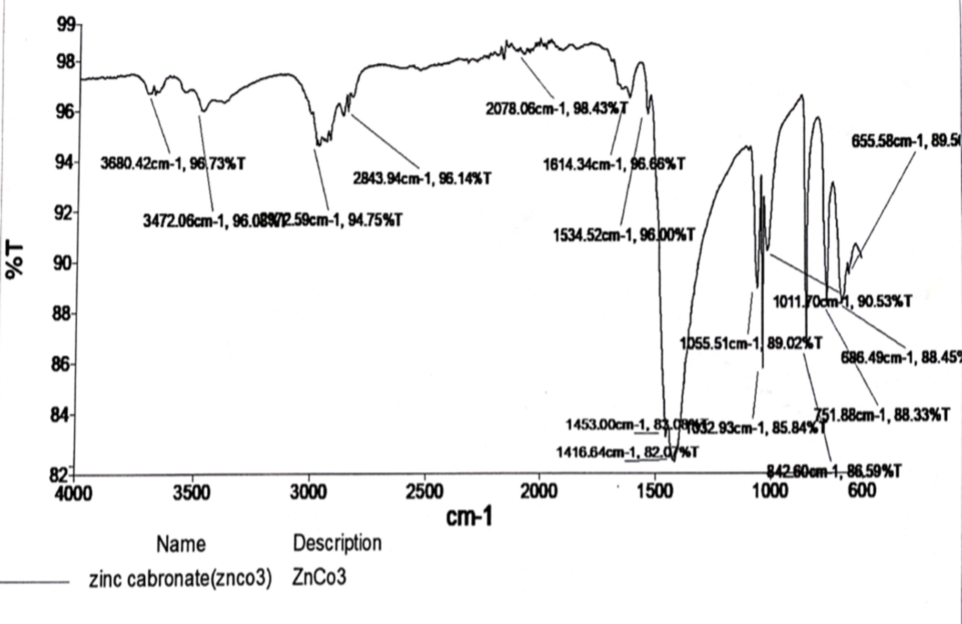
Sodium tricarbonato zinc

Slide 8
Result and Discussion
The complex’s Sodium tricarbonato Manganate(III) and Sodium tricarbonato zincate (III) were obtained as a brown and white solid as respectively.
The Mn and Zn metal ions in both complexes were obtained from MnCl₂.6H₂O and ZnCl₂.6H₂O as its source respectively.
Even though the structure was not determined in this work, on the basis of previous works it have shown the structure of Tricarbonatozinc and Tricarbonatomanganese to be tetrahedral.
The filtrate of the last stage of the formation of the product were used to form a new crystalline solids, whose name have been determined based on previous studies as, Sodium Dicarbonato-diamminezinc(III) and Sodium Dicarbonato-diamminemanganese(III).

Slide 9
APPLICATIONS
Manganese carbonate is used as a fertilizer in agriculture to correct manganese deficiency in the soil. It is also used as a feed supplement for livestock to prevent and treat manganese deficiency.
Manganese carbonate is used in the production of ceramics as a coloring agent. It gives a pink, brown, or black color to the ceramics.
Manganese carbonate is used in water treatment processes to remove iron and manganese from water.
It serves as an astringent, antiseptic, and topical wound protector in animals.
Zinc carbonate is sometimes administered as a micronutrient to prevent disease in animals.
It is used as a fireproof filler for rubbers and plastics that are exposed to high temperatures.

Slide 10
CONCLUSION
The Ammine-Carbonato series of Zinc and Manganese were obtained successfully.
The synthesized metal complexes involved the combination of metal ions with carbonate ions, resulting in the formation of solid coloured metal carbonate compounds.
This study have shown that the properties of these compounds can be tuned by adjusting the reaction conditions during synthesis.
The pure and good yield of product is obtained from this method.
Each of these metal compunds exhibited unique properties and characteristics, such as varying solubilites and colour.
These compounds have potential applications in catalysis, biomedicine, and materials science.

Slide 11
REFERENCES
Motoshichi et. al, Bulletin of the Chemical Society of Japan 1956 29:8, 883-886.
B. HUTERA, A. KMITA, E. OLEJNIK, T. TOKARSKI Synthesis of Zno Nanoparticles by Thermal Decomposition of Basic Zinc Carbonate Article in Archives of Metallurgy and Materials · January 2013
Microwave solvothermal synthesis and characterization of manganese doped ZnO nanoparticles DOI: 10.3762/bjnano.7.64 ISBN: 2190-4286
Biradar, N. S., & Pujar, M. A. (1972). Nuclear magnetic resonance and electronic spectral studies of Carbonato-ammine Cobalt(III) Complexes. Zeitschrift For Anorganische Und Allgemeine Chemie, 391(1), 54–59.
Pan, D., Schmieder, A. H., Wickline, S. A., & Lanza, G. M. (2011). Manganese-based MRI contrast agents: past, present, and future. Tetrahedron, 67(44), 8431–8444.
Remineralization of Artificially Demineralized Human Enamel and Dentin Samples by Zinc-Carbonate Hydroxyapatite Nanocrystals October 2022 Materials 15(20):7173
Refat, M. S. (2014). Preparation of manganese(II), chromium(III) and ferric(III) oxides nanoparticles in situ metal citraconate complexes frameworks. Spectrochimica Acta Part A: Molecular and Biomolecular Spectroscopy, 133, 281–291.
Synthesis, Crystal Structures, and DNA Binding Properties of Zinc(II) Complexes with 3-Pyridine Aldoxime Konstantis F. Konidaris,1 Rigini Papi,2 Eugenia Katsoulakou,1 Catherine P. Raptopoulou,3 Dimitrios A. Kyriakidis,2 and Evy Manessi-Zoupa
Synthesis, Characterization, and Biological Activity of Some Transition Metal Complexes Derived from Novel Hydrazone Azo Schiff Base Ligand C. Anitha,1 S. Sumathi,1 P. Tharmaraj,1 and C. D. Sheela
Ali, S., Iqbal, Y., Shah, K. H., & Fahad, M. (2020). Synthesis and kinetic modeling of manganese carbonate precipitated from manganese sulfate solution. Chemical Engineering Communications, 1–12.

Slide 12
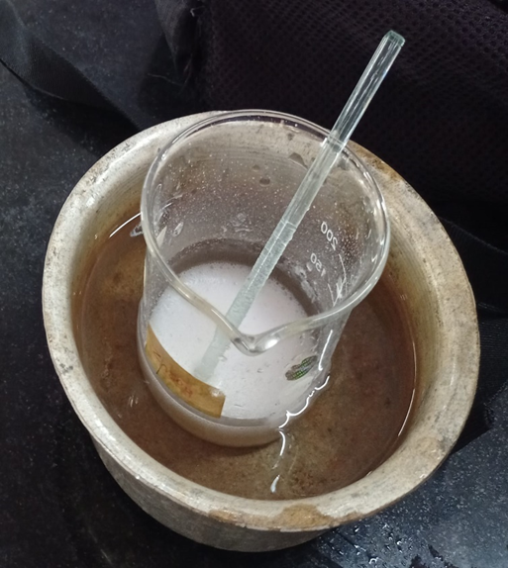
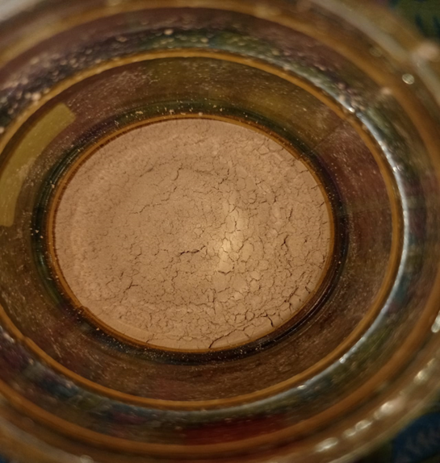
THANK
YOU

